Slide 1
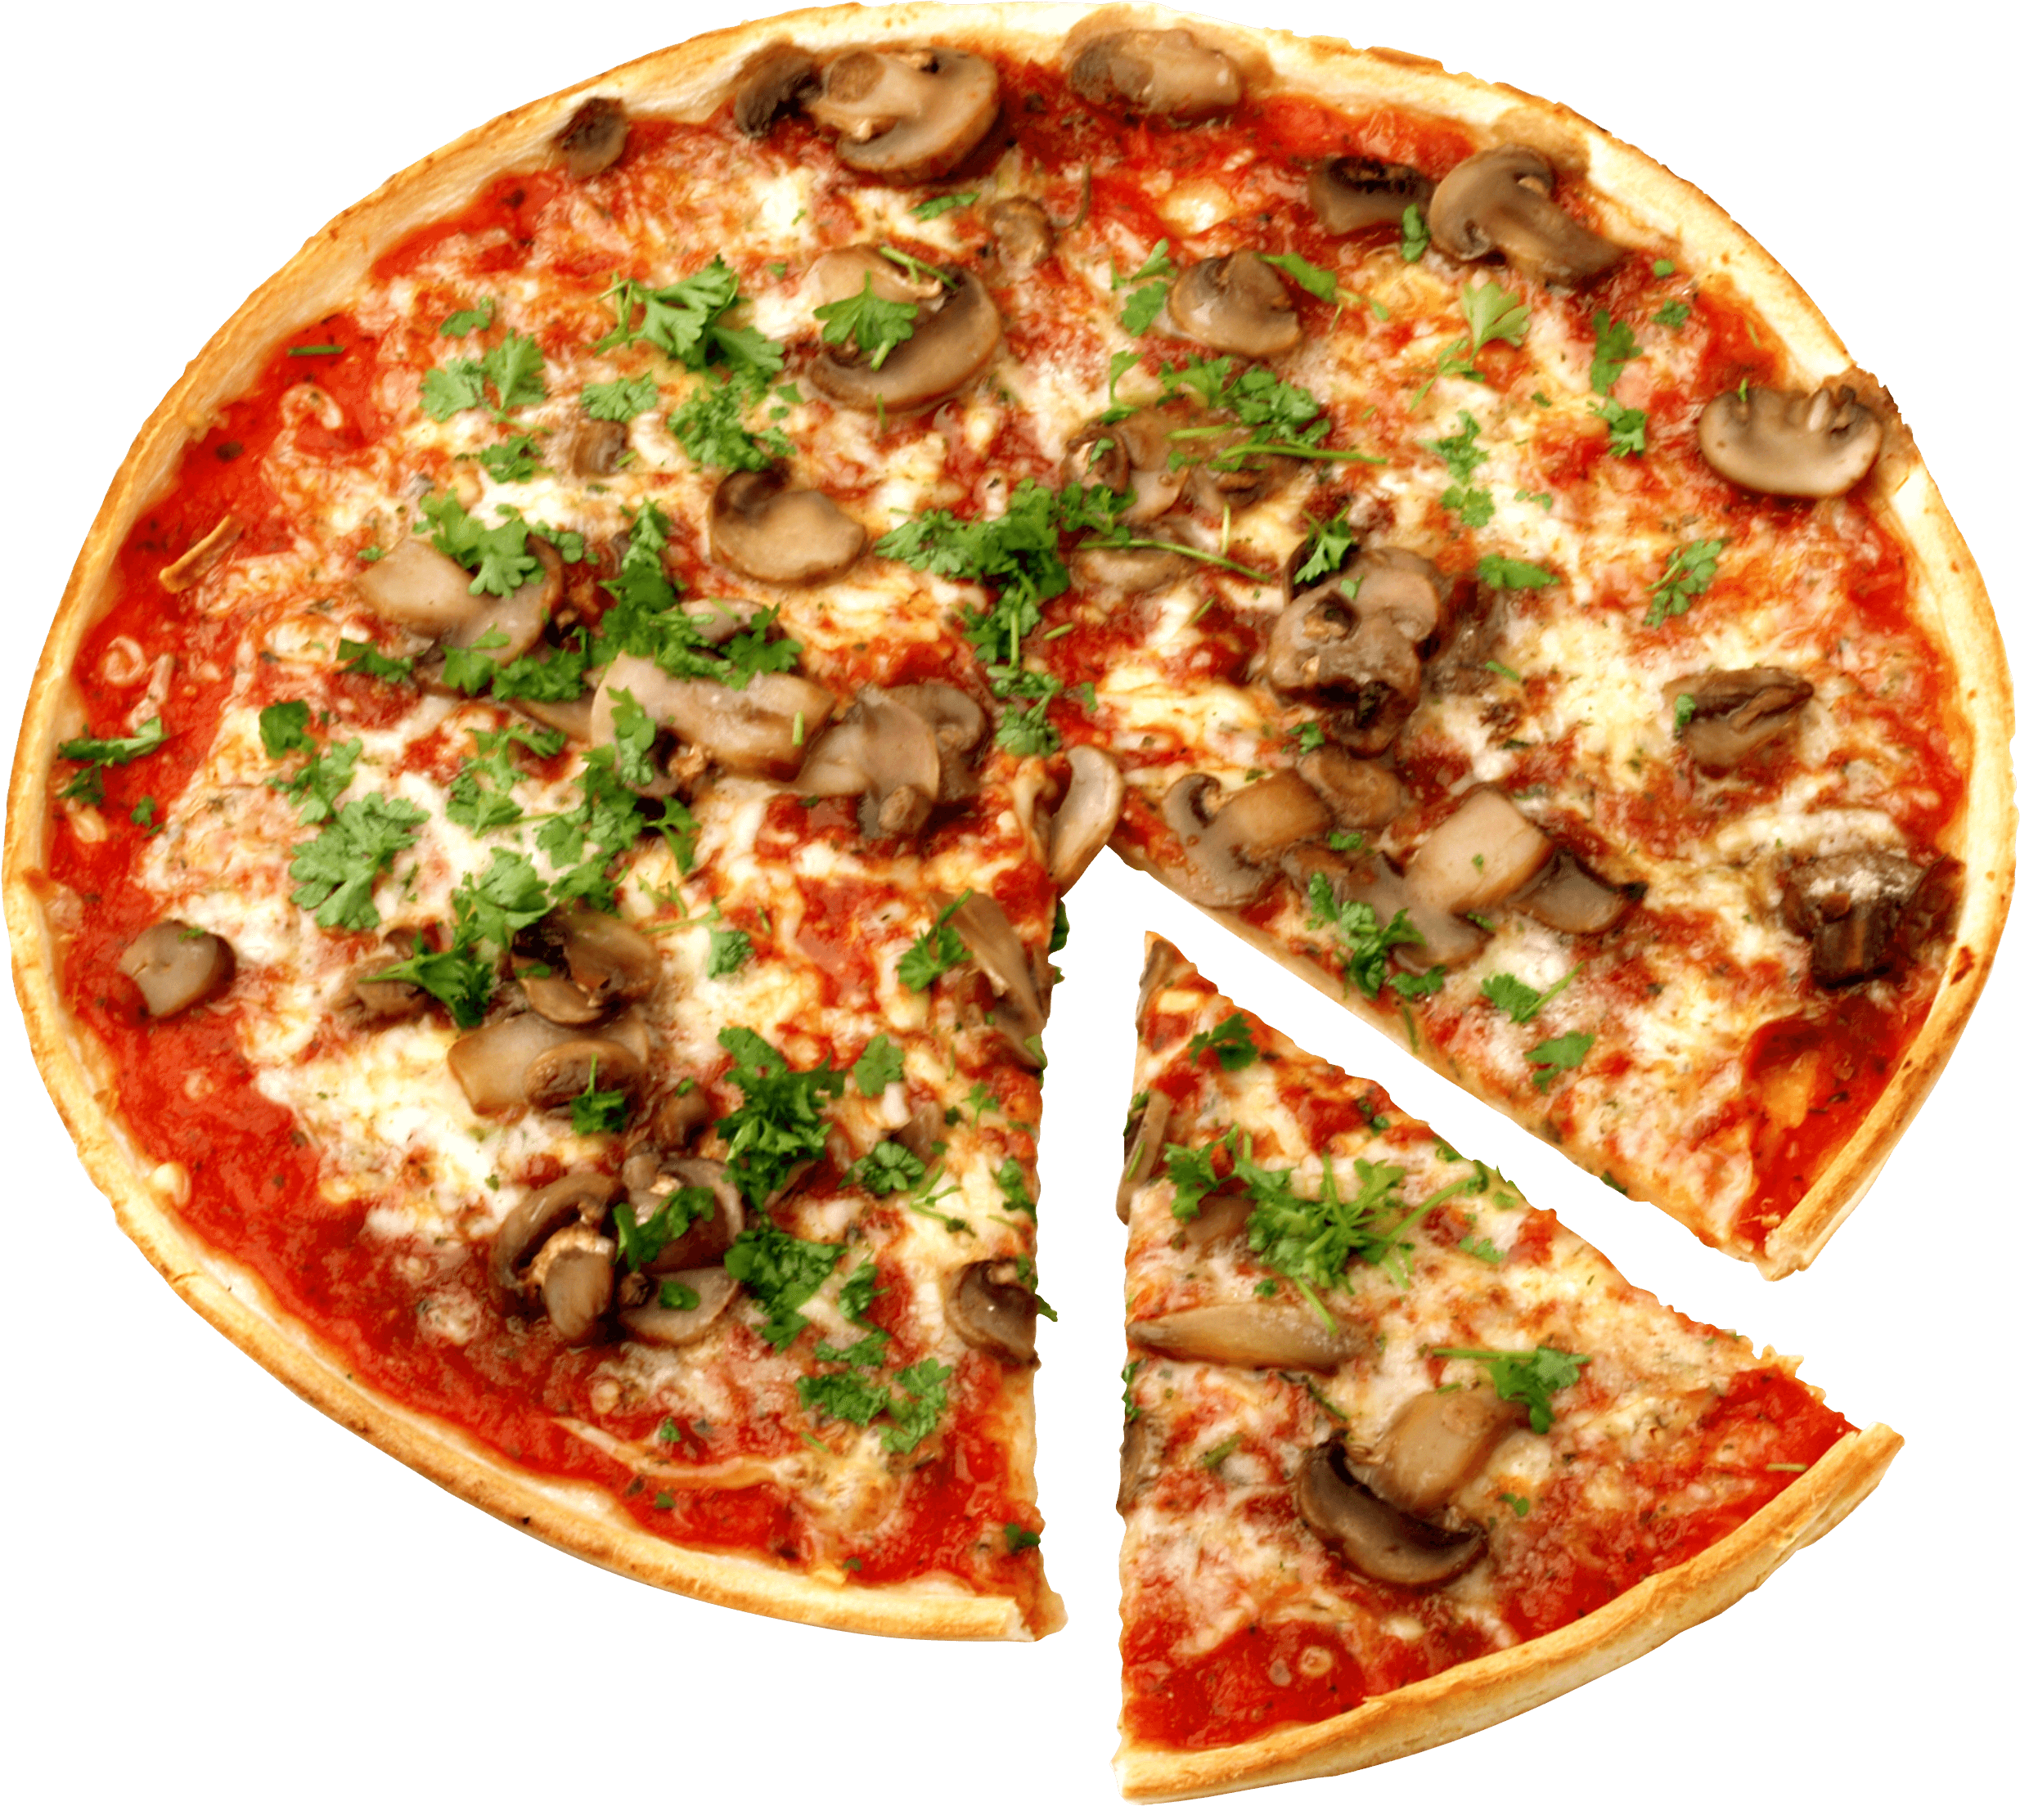
Pizza Sales Report Analysis
Analyzing Trends, Performance, and Opportunities
Presenter Name: Olalere Nurudeen Alowonle
Techie Academy
Date: July 12, 2025

Slide 2
Presentation Overview
01
Introduction
04
Hourly Trends and Insights
02
Sales Overview
05
Customer Insights
03
Pizzas Performance
06
Challenges & Opportunities
Q&A
Recommendation
08
07

Slide 3
Introduction Why This Matter?
Content:
Objective: The goal is to uncover insights for Techie Pizza. For example.
Trends: Are Fridays consistently the busiest day ? Is CLASSIC the best-selling category?
Is the cake pizza leading in sales because of its ingredients
Areas of improvement: Is veggie category really underperforming, perhaps due its ingredient or low customer traffic?
The objective above is to tell the management team that the analysis will help them make decisions, like promoting popular pizzas or addressing issues on the underperforming pizzas.
Time Period: January-December 2015
Scope: All four categories of pizzas sales. For example.
The barbecue chicken pizza is leading in sales due to its popularity and love for chicken
The veggie category is underperforming due to its combination of ingredients

Slide 4
Pizza Sales Database Schema
This diagram represents the relationship between the key tables used in pizza sales dataset which includes : order, order_details , pizzas, pizzas_ types Csv datasets.
Understanding this schema enable accurate calculations and visualization in Power Bi.
Orders order_id order_date order_time
Order_details Order_details_id order_id Pizza_id quantity
Pizzas Pizza_id Pizza_type_id size price
Pizzas_types Pizza_type_id name category Ingredients

Slide 5
Sale’s Overview
Business Implications
Revenue Chart Implications
Cash Flow Management: Your business maintains steady revenue ($6500-73000 range) even when order volumes fluctuate dramatically - this is excellent for financial planning and loan commitments.
Premium Strategy Works: Higher revenue during lower-order periods means customers are buying more expensive pizzas/combos when they do order - your upselling is effective.
Order Chart Implications
Operational Flexibility Needed: Order swings of 30% (3,000 to 4,300) require flexible staffing and inventory management to avoid waste or understaffing.
Customer Retention Risk: Fewer orders could mean losing customers to competitors - need retention campaigns during low months.
Business Insights
Pricing Power: We can charge premium prices when demand drops - customers who stay are less price-sensitive.
Staffing Strategy: We can plan for 30% staff reduction in Sept-Oct, then do a rapid hiring for Nov recovery.
Profitability Focus: September-October might be our most profitable months (fewer orders but stable revenue = higher margins per order).
Growth Opportunity: The order volatility suggests untapped market potential – our consistent in marketing could smooth these fluctuations and boost overall revenue.
Bottom Line: We have a resilient revenue model but volatile customer engagement - our focus should be on customer retention and operational flexibility.

Slide 6
Sale’s Overview

Slide 7

Sale’s Overview
Total Revenue
$817,860
Total Pizza Sold
50k

Slide 8
Pizza’s Performance What’s Hot On The Menu?
Revenue Distribution
Champion: Thai Chicken Pizza leads at $43,434.25 (34% of top 3 revenue)
Close Second: Barbecue Chicken Pizza at $42,768.00 (33% )
Third Place: California Chicken Pizza at $41,409.50 (32% )
Business Insights
Chicken Dominance: All top performers are chicken-based pizzas this clearly states that customers have a clear protein preference that drives sales.
Revenue Balance: Remarkably even split ($2,000 difference between 1 and 3) indicates we have multiple strong sellers, not just one star product.
Menu Strategy: These three pizzas represent our core profit drivers they should get prime menu placement and consistent ingredient availability.
Customer Preference: The tight competition suggests diverse taste preferences within our chicken-loving customer base - Thai, BBQ , and California styles all perform equally well.
Marketing Opportunity: Since performance is so close, we can do a small promotional pushes which could easily shift rankings and boost overall chicken pizza category sales.
Bottom Line: We've struck gold with chicken pizzas – our focus should be marketing and operations around this protein while we maintain quality across all three winners.

Slide 9
Pizza’s Performance
Total Pizza Sold
50k

Slide 10
Pizza’s Performance
Worst Selling Pizza Chart
Data Insights
Bottom Performer: Mexicana leads underperformers at $2,000 revenue
Consistent Struggle: All five pizzas cluster between $1,000-$2,000 - extremely low sales
Names: Green Garden, Don Alfredo's, Calabrese, and The Greek also underperform
Business Implications & Insights
Menu Optimization: These pizzas are taking up valuable menu space and ingredient costs – I suggest we consider removing them.
Cost Drain: Low sales mean ingredients expire, storage costs increase, and staff waste time on unpopular items.
Customer Feedback: These failures clearly reveal what our market doesn't want – we should avoid similar flavor profiles in future.
Best Selling Pizza Chart
Data Insights
Champion: Thai Chicken dominates at 30,000 sales
Strong Performers: Five Cheese, Four Cheese, Spicy Thai, and Big Meat all perform well (22,000-26,000 range)
Clear Winners: Significant gap between best and worst performers
Business Implications & Insights
Focus Strategy: These five pizzas generate most of our sales - prioritizing their quality and availability will boost overall revenue
Marketing Gold: We can use these proven sellers in promotions and featured menu positions.
Profit Maximization: We should make sure these pizzas have optimal pricing and upselling opportunities.

Slide 11
Monthly Trends and Insights
Seasonal Patterns
Summer Peak: July hits the highest sales at 72,500, indicating summer is our strongest season
Winter Dip: October shows a dramatic crash to just 6,400 sales - the lowest point of the year
Recovery: November bounces back strongly to 70,400, nearly matching summer levels
Business Insights
Prepare for October: This massive 91% drop suggests seasonal factors (weather, holidays, or local events) significantly impact sales
Summer Strategy: July's peak performance shows when to maximize our marketing and staffing
Year-End Opportunity: The November recovery indicates strong potential for holiday season sales
Overall Trend: Sales remain relatively stable (65,000-72,500) for most months except for the October anomaly; this suggest we have a healthy business with one significant seasonal challenge to address.

Slide 12
Hourly Trends and Insights
Peak Performance: Pizza orders hit their highest volume at 12 PM (6,543 orders), indicating lunch is the strongest sales period.
Steady Decline: There's a consistent downward trend throughout the afternoon and evening, with orders dropping from 6,203 at 1 PM to 4,350 by 7 PM.
Business Implications:
Staffing: We need maximum staff coverage during the lunch rush (11 AM - 1 PM)
Inventory: We prepare more ingredients and supplies for the 12 PM peak
Marketing Opportunity: The significant drop after lunch suggests potential for dinner promotions to boost evening sales.
The data shows a classic lunch-driven pizza business pattern, where midday hunger drives the majority of sales, with a notable 38% decline from peak to evening hours

Slide 13
Customer Insights
Techie Pizza Context: Data from January-December 2015 shows that the THAI_CKN generates 5.31% of the total revenue, our customers tends to order this most due to the unique and delicious combination of flavors and textures.
The Chicken category shows that 26.91% of our customer order pizza under this category mostly because of its loyal program(Buy Two & Get One For Free) and its popularity
Based on recent reviews on our official websites this data shows that 30% of customer dropped bad reviews and comments on the Veggie category of pizza regarding the combination of ingredient used and the texture of the pizza.
The Loyalty program on the Chicken category, offering a free pizza after two orders, drives 20% of sales from repeat customers. This suggests a young , digital-first customer base that values convenience and rewards.
Impacts: Marketing can target young professionals on social media (e.g., Instagram ads) and expand the loyalty program to boost repeat purchases.

Slide 14
Challenges & Opportunities
Challenges: The brie_carre pizza accounts for only 1.42% of sales ($11,588.50), possibly due to its low demand because of its flavor and texture. Delivery delays on Friday as the busiest day during lunch hours 12-2PM (30% of orders) cause customer complaints, averaging 35 minutes vs domino’s 25 minutes.
Opportunities: Promote extra cheese (2,000 units sold) and soda (1,500 units) as upsells items , especially with the barbecue chicken pizzas (5.23% of revenue). Target dinner hours (6-8PM, currently only 10% of orders) with meal deals. Monetize the mobile app as we generate a lot of traffic than the official website.
Impact: Removing or rebranding the brie_carre pizza could free up menu space or rather do a thorough check through of its ingredients. Promotion on the barbecue chicken pizzas could boost sales by 20%, and faster delivery could improve ratings.

Slide 15
Recommendations
Launch a $5,000 social media campaign on the barbecue chicken pizza targeting college students to boost its sales, leveraging Instagram ads for the adult customers.
Introduce another combo deal related to the barbecue chicken pizza which is under chicken category to supreme category ( The classic deluxe pizza + extra cheese + soda) to start a sale competition with the thai chicken pizza.
Hire additional delivery drivers for Fridays 6-8PM 30% of daily orders, to reduce delivery time from 35 minutes to 25 minutes, matching domino’s
Impact: Media campaign could increase by 20%, combo deals could boost add-on revenue by 15%, and faster delivery could improve customer ratings from 4.5 to 4.7/5
4. Reinforce the brand with a subtle pizza or logo.

Slide 16
Q&A
How will the $5,000 social media campaign target college students?
Answer: Instagram ads for adult group, offering discounts to the college student.
Can we reduce delivery time without hiring more drivers?
Answer: Optimize routes or partner with a delivery app
Should we discontinue the Brie_carre pizza?
Answer: Test a rebranded versions before removing it

Slide 17
Thank You

